Slide 1
Evaluación de resultados

Slide 2
Métricas de evaluación
 |  | Métricas\Modelo | Random Forest | Decision Tree Regression | RNA
Data set Creada (SMOTE) | Test: 20% | Accuracy | 37.55% | 65.99% | 51.15%
 |  | Recall | 65.30% | 66.24% | 51.68%
 |  | Precision | 38.83% | 66.22% | 54.27%
 | Test: primeros 498 registros | Accuracy | 79.07% | 80.92% | 37.15%
 |  | Recall | 79.07% | 86.64% | 55.36%
 |  | Precision | 78.44% | 70.30% | 35.17%
Data set del estudio | Test: 20% | Accuracy | 66.67% | 75.65% | 72.34%
 |  | Recall | 67.44% | 75.34% | 70.27%
 |  | Precision | 77.19% | 74.50% | 70.27%
 | Test: primeros 498 registros | Accuracy | 16.87% | 83.73% | 42.37%
 |  | Recall | 23.98% | 81.17% | 45.64%
 |  | Precision | NaN | 77.06% | 32.88%

Slide 3
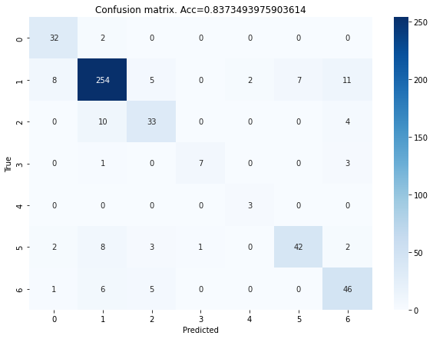
Matriz de confusión (Decision Tree Regression)

